Slide 1
Unfreedom (February 26, 2020b)
J. Bradford DeLong
Spring 2019
Evans 648
W 1:10-3:00 pm
<https://bcourses.berkeley.edu/courses/1487686/>
<https://github.com/braddelong/public-files/blob/master/econ-210a-lecture-6b.pptx>

Slide 2
Assignment: Unfreedom
What relevance and use does a work like Karl Marx and Friedrich Engels (1848), "Manifesto of the Communist Party" have to twenty-first century economists today?
Readings:
Karl Marx and Friedrich Engels (1848): Manifesto of the Communist Party <http://www.marxists.org/archive/marx/works/1848/communist-manifesto/>
Stanley Engerman and Kenneth Sokoloff (1994): Factor Endowments, Institutions and Differential Paths of Development among New World Economies <http://papers.nber.org/papers/h0066>
Put off to March 4: Nathan Nunn (2008): The Long-Term Effects of Africa’s Slave Trades <http://www.jstor.org/stable/pdfplus/25098896.pdf>

Slide 3

Reading Marx and Engels
Karl Marx and Friedrich Engels (1848): Manifesto of the Communist Party <http://www.marxists.org/archive/marx/works/1848/communist-manifesto/>:
The bourgeoisie has played a most revolutionary role in history…
Previous upper classes consumed and wasted…
This upper class invests and pushes forward technological development
Because increasing returns mean that if you don’t keep up, you go bankrupt—and join the proletariat

Slide 4
Contrast with Adam Smith
Adam Smith:
Property, contract, “easy taxes”, & the division of labor get us as close to utopia as is humanly attainable…
“a general plenty diffuses itself through all the different ranks of the society. Observe the accommodation of the most common artificer or day-labourer in a civilised and thriving country, and you will perceive that the number of people of whose industry a part... has been employed in procuring him this accommodation, exceeds all computation…"
But many requirements in addition…

Slide 5
Contrast with Adam Smith II
But many requirements in addition:
Freedom—no slavery, no serfdom
Overcoming the “love to domineer”
State capacity—trade away your retainers for conveniences and luxuries
Government providing national defense
Government providing infrastructure
Government providing public education
Enforcing the government’s property-rights order against roving bandits, local notables, and the government’s own functionaries is no joke…

Slide 6
Contrast with Adam Smith III
Holes in the argument:
It’s the “system of natural liberty”, but it doesn’t develop naturally save in western Europe (and perhaps in China, or rather in Smith’s image of China…
Hunter, shepherd, agrarian, commercial societies—the move to the last requires a long period of political-social development
The division of labor is determined by the extent of the market; but Smith’s example is of a command-and-control division of labor: a pin factory
Smith has no clue as to what is coming with non-human power—although he does see something like the assembly line
The Malthusian demon lurks in the back of Smith’s argument (even an 0.44%/yr Industrial Revolution ideas-stock growth rate soaked up by population growth of 0.88%/yr: you don’t get to the demographic transition).

Slide 7

Reading Marx and Engels
The market economy cannot produce an acceptable distribution of wealth:
Why not? Marx disappears into the swamp of the labor theory of value
Marx confuses the physical capital-output ratio with the value capital-output ratio
Marx assumes a floor to the rate of profit
So accumulating capital pushes wages down to subsistence
Then with further accumulation wages need to fall further, but can’t
So profit expectations are disappointed—a capital strike follows
So financial crisis, depression, destruction of capital, &c.
& then the process starts over again at a higher intensity
& eventually the Revolutionary Moment comes…

Slide 8
Reading Marx and Engels
Then with further accumulation wages need to fall further, but can’t:
So profit expectations are disappointed—a capital strike follows
So financial crisis, depression, destruction of capital, &c.
& then the process starts over again at a higher intensity

Slide 9


Full Communism!
& eventually the Revolutionary Moment comes…:
FULL COMMUNISM!
A free and democratic society of associated producers
(Contrast with Germany 1919)

Slide 10
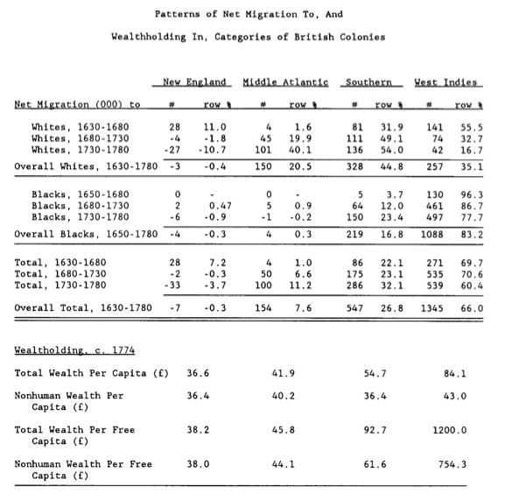
Reading Engerman and Sokoloff
Stanley Engerman and Kenneth Sokoloff (1994): Factor Endowments, Institutions and Differential Paths of Development among New World Economies <http://papers.nber.org/papers/h0066>:
Engerman and Sokoloff: A historical take on the “reversal of fortune” and “institutions” literatures…
Variables that “win” regressions:
Not in sub-Saharan Africa
Distance from the equator
Source of your colonial settler population or your colonial administrators (“legal origins”)
Investment—especially equipment investment
Look for instruments?
Adding instruments—even invalid instruments—raises the r2 of the first stage…
If you have “a lot” of instruments, you will get OLS…
Staiger and Stock: need 10-20 observations per instrument…
Tell stories?
Correlations, causal experiments, case studies…

Slide 11
Engerman and Sokoloff: “Reversal of Fortune” and “Institutions” Literatures
Variables that “win” regressions:
Not in sub-Saharan Africa
Distance from the equator
Source of your colonial settler population or your colonial administrators (“legal origins”)
Investment—especially equipment investment
Look for instruments?
Adding instruments—even invalid instruments—raises the r² of the first stage…
If you have “a lot” of instruments, you will get OLS…
Staiger and Stock: need 10-20 observations per instrument…
Tell stories?

Slide 12
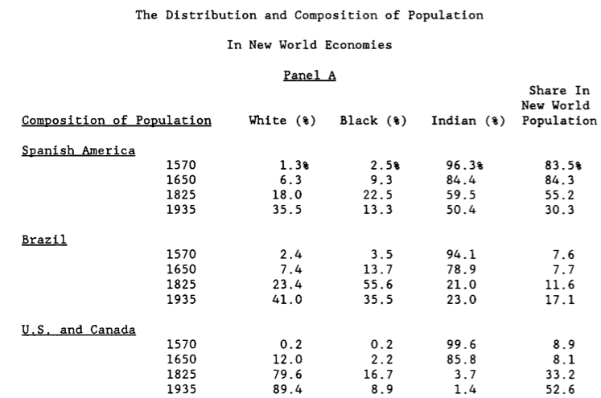
New World Populations

Slide 13
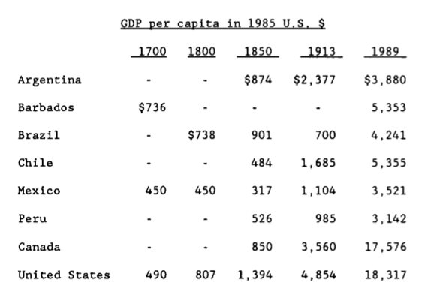
New World Growth

Slide 14
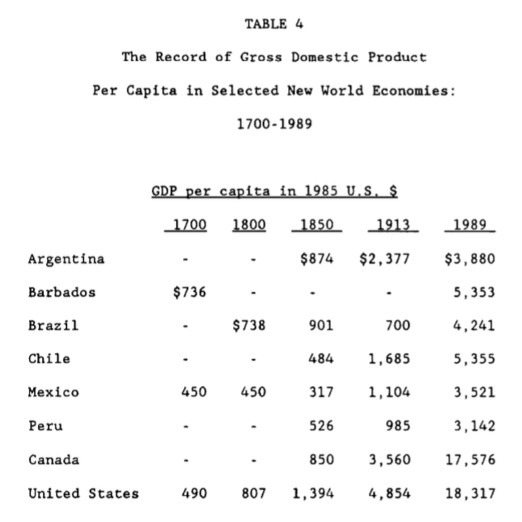
Engerman and Sokoloff: Very Long Run Consequences of Being Ruled by Slave- or Serf-Masters
Different labor systems as the result of the luck of history and “factor endowments”
How do you establish an unfree labor system?
How do you maintain an unfree labor system?
What does having an unfree labor system do to elite incentives?
Does the elite control the economy? If so, does it control it in its long-run interest?

Slide 15
Assignment Next Time:
Women and Children
Essay Topic:
The most important economic change of the past two centuries has been the shift from a "Malthusian" world—in which the typical woman and her children live near subsistence, with the absence of infant formula and easy artificial family planning mechanisms plus the desire to have surviving descendants in a world where average lifespan is less than 30 leads the typical woman to have on average perhaps nine pregnancies to achieve 6.5 live births, 4 children who survive infancy, and 3 to reach near-adulthood; thus spending 20 years "eating for two"—to our current world. Discuss.
Readings:
Abigail Smith Adams (1776): Letter to John Adams 31 March - 5 April 1776 <https://www.masshist.org/digitaladams/archive/doc?id=L17760331aa>
Martha Bailey (2013): Fifty Years of Family Planning: New Evidence on the Long-Run Effects of Increasing Access to Contraception <http://www.nber.org/papers/w19493>
Claudia Goldin (1991): The Role of World War II in the Rise of Women’s Employment <http://www.journals.uchicago.edu/doi/abs/10.1086/649603>
Heather Antecol, Kelly Bedard, and Jenna Stearns (2018): Equal but Inequitable: Who Benefits from Gender-Neutral Tenure Clock Stopping Policies <https://pubs.aeaweb.org/doi/pdf/10.1257/aer.20160613>
& Nunn…

Slide 16
Question
Should there be more readings for next week?
YURII!!
Nathan Nunn (2008): The Long-Term Effects of Africa’s Slave Trades <http://www.jstor.org/stable/pdfplus/25098896.pdf>
Abigail Smith Adams (1776): Letter to John Adams 31 March - 5 April 1776 <https://www.masshist.org/digitaladams/archive/doc?id=L17760331aa>
Martha Bailey (2013): Fifty Years of Family Planning: New Evidence on the Long-Run Effects of Increasing Access to Contraception <http://www.nber.org/papers/w19493>
Claudia Goldin (1991): The Role of World War II in the Rise of Women’s Employment <http://www.journals.uchicago.edu/doi/abs/10.1086/649603>
Heather Antecol, Kelly Bedard, and Jenna Stearns (2018): Equal but Inequitable: Who Benefits from Gender-Neutral Tenure Clock Stopping Policies <https://pubs.aeaweb.org/doi/pdf/10.1257/aer.20160613>

Slide 17
Catch Our Breath…
Ask a couple of questions?
Make a couple of comments?
Any more readings to recommend?

Slide 18
Notes…

Slide 19
Reading Nunn
Nathan Nunn (2008): The Long-Term Effects of Africa’s Slave Trades <http://www.jstor.org/stable/pdfplus/25098896.pdf>:
“The inclusion of the capital investment data diminishes the importance of learning. Without capital data, a ceteris paribus doubling of cumulative output is estimated to increase monthly output by 41 percent; the inclusion of capital reduces this estimate to about 22 percent…”
“Quality…productivity mismeasurement… induces mismeasurement equivalent to only about 5 percent of observed productivity growth…”

Slide 20
Emergency Shipbuilding Program
Liberty ship, an all-welded cargo ship with a displacement of 7,000 tons
16 U.S. shipyards delivered a total of 2,699 ships
A substantial portion of ship construction undertaken “off the ways”
600,000 feet of welded joints
Welding labor accounted for about one-third of direct labor
Lots of new welders…
A cadre, and—some—managers with experience. Otherwise…

Slide 21
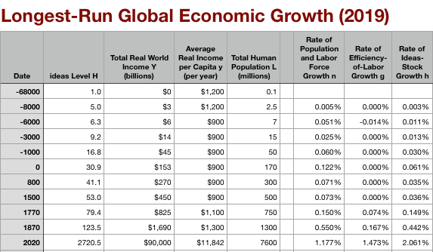
Global and “Western” Numbers
The Commercial Revolution acceleration appears everywhere
Due to globalization
And especially to the “Columbian Exchange”

Slide 22

“Western” Numbers
Is ‘the west’ special between 800 and 1500?
Or is it just recovery from a Dark Age depression?

